Slide 1
Template for Project Presentation
8 mins presentation time per group. Does not include Q&A time. One or more group members can present.
Submission requirements
PowerPoint slides, Python notebook (if written new code including scrapers). No data files should be submitted
Details can be provided on the slides themselves as notes (no report is required)
Slide 1: Project title and group member names
Slide 2: The problem statement, why it matters
Slides 3-4: Data source(s), search keywords (if applicable), frequency of important words, any pre-processing (e.g., merging of words or data, if applicable)
Slides 5-6: Analysis and results – e.g., sequence of analysis, lift, MDS, topic modeling, sentiment analysis, etc. (not all may be applicable)
Slide 7-8: Insights/recommendations from analysis
Upload presentation to Canvas by 8:30 a.m. on 10/18

Slide 2
Trump Tweets Sentiment Analysis
Disha Gandhi, Aditya NVS, Apurva Audi, Muskaan Singhania, Tanvi Dalal

Slide 3
Problem Statement & how it
What could Trump do better on social media to better position himself for elections?
Through the the analysis of Trump’s 2015 and 2019 election campaigns tweets, can we advise Trump on how to approach the 2023 elections?
Why it's important:
-Understand the direct and indirect impact of posting, deleting, and retweeting tweets
-Breakdown the sentiment analysis to see which topics incur the largest reactions

Slide 4
Approach

Slide 5
Datasource & PreProcessing
Sentiment Analysis using VADER
Removed emojis, RT, punctuations, mentions, links, stopwords, numbers , and other unessential words.
Total tweets: Archive~56,000(2009-2021)
Current Tweets~6,000(2022)
Word Tokenization
Lemmatization

Slide 6
Datasource & PreProcessing
Used the frequency of the top words to conduct lift analysis

Slide 7
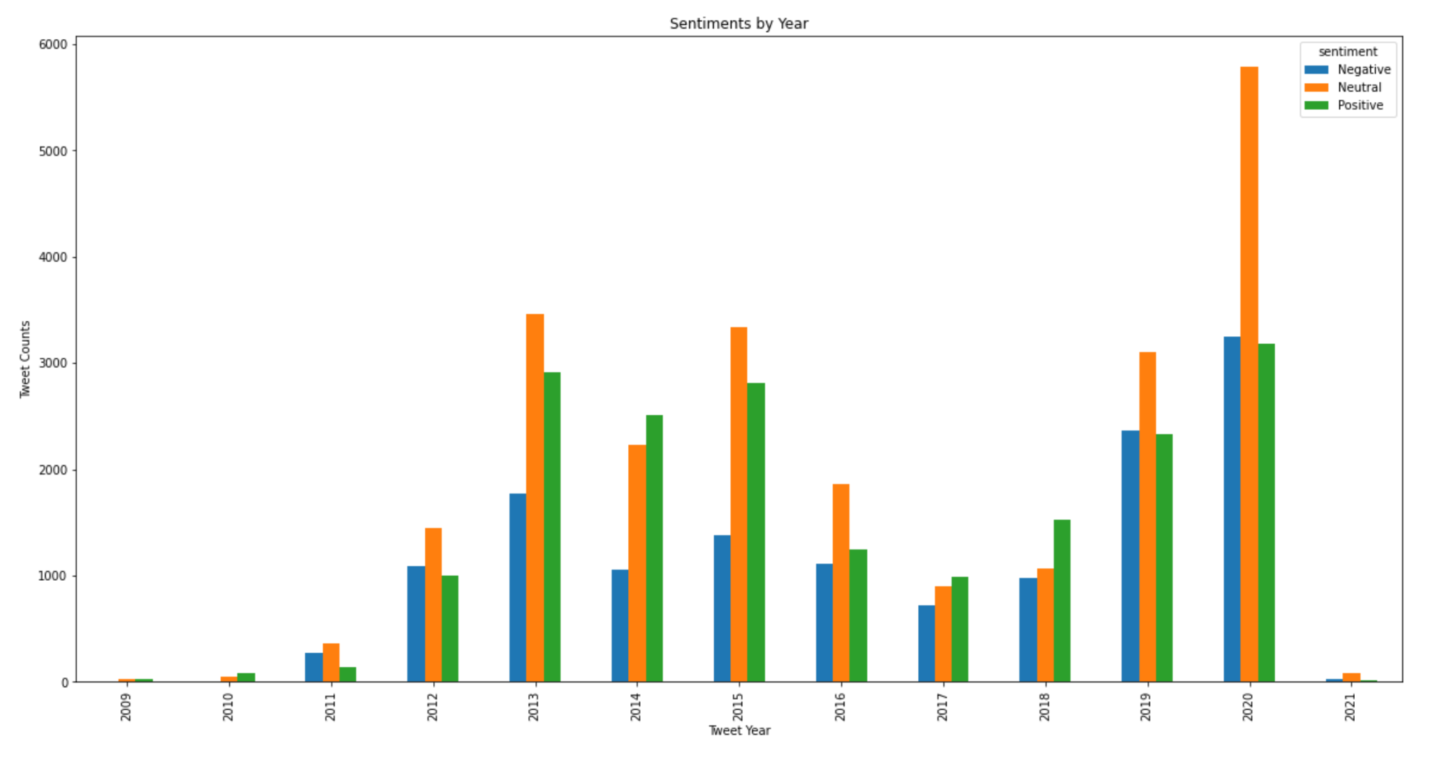
Analysis
Used Vader score to conduct sentiment analysis
Used tokenized words to conduct Lift analysis
Conducted MDS for three times: 2015, 2019, and 2022

Slide 8
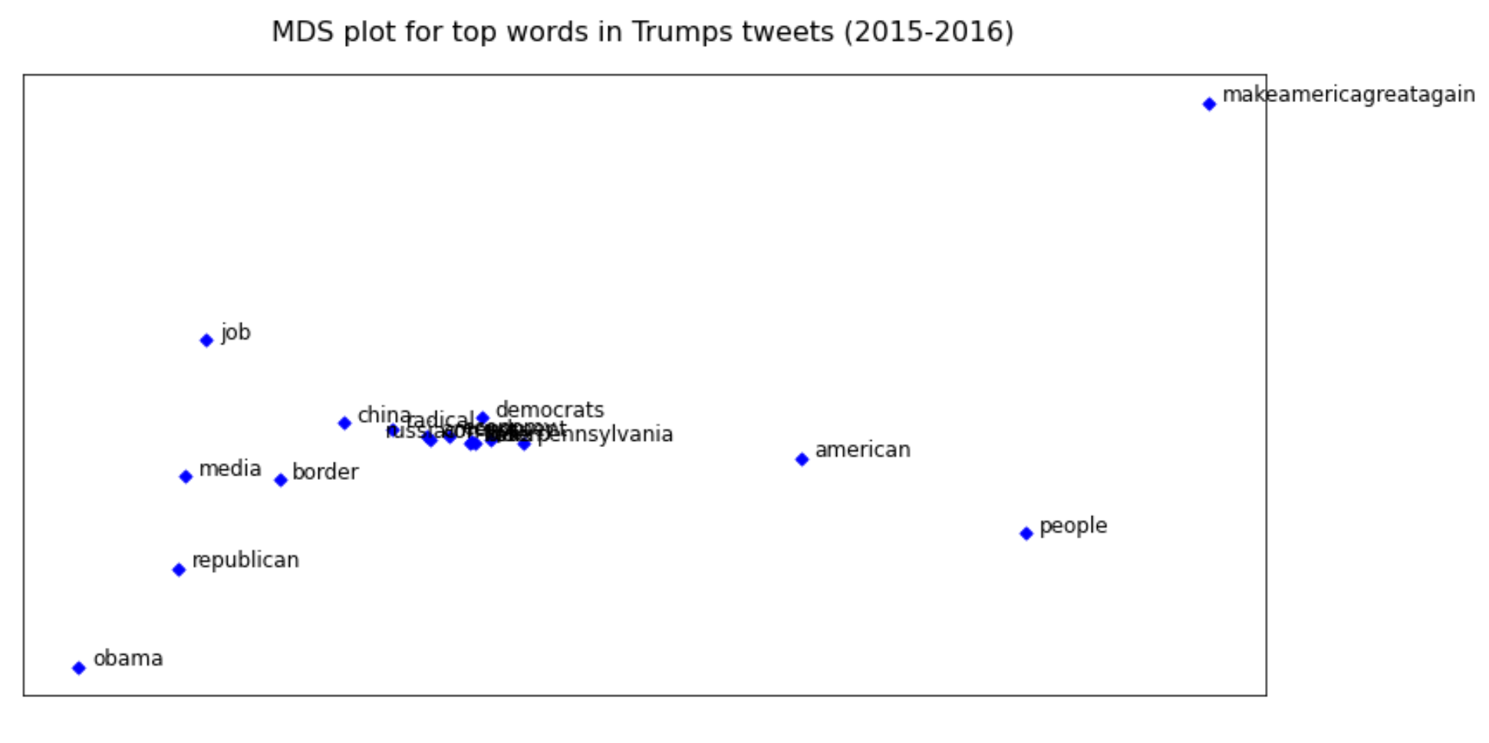
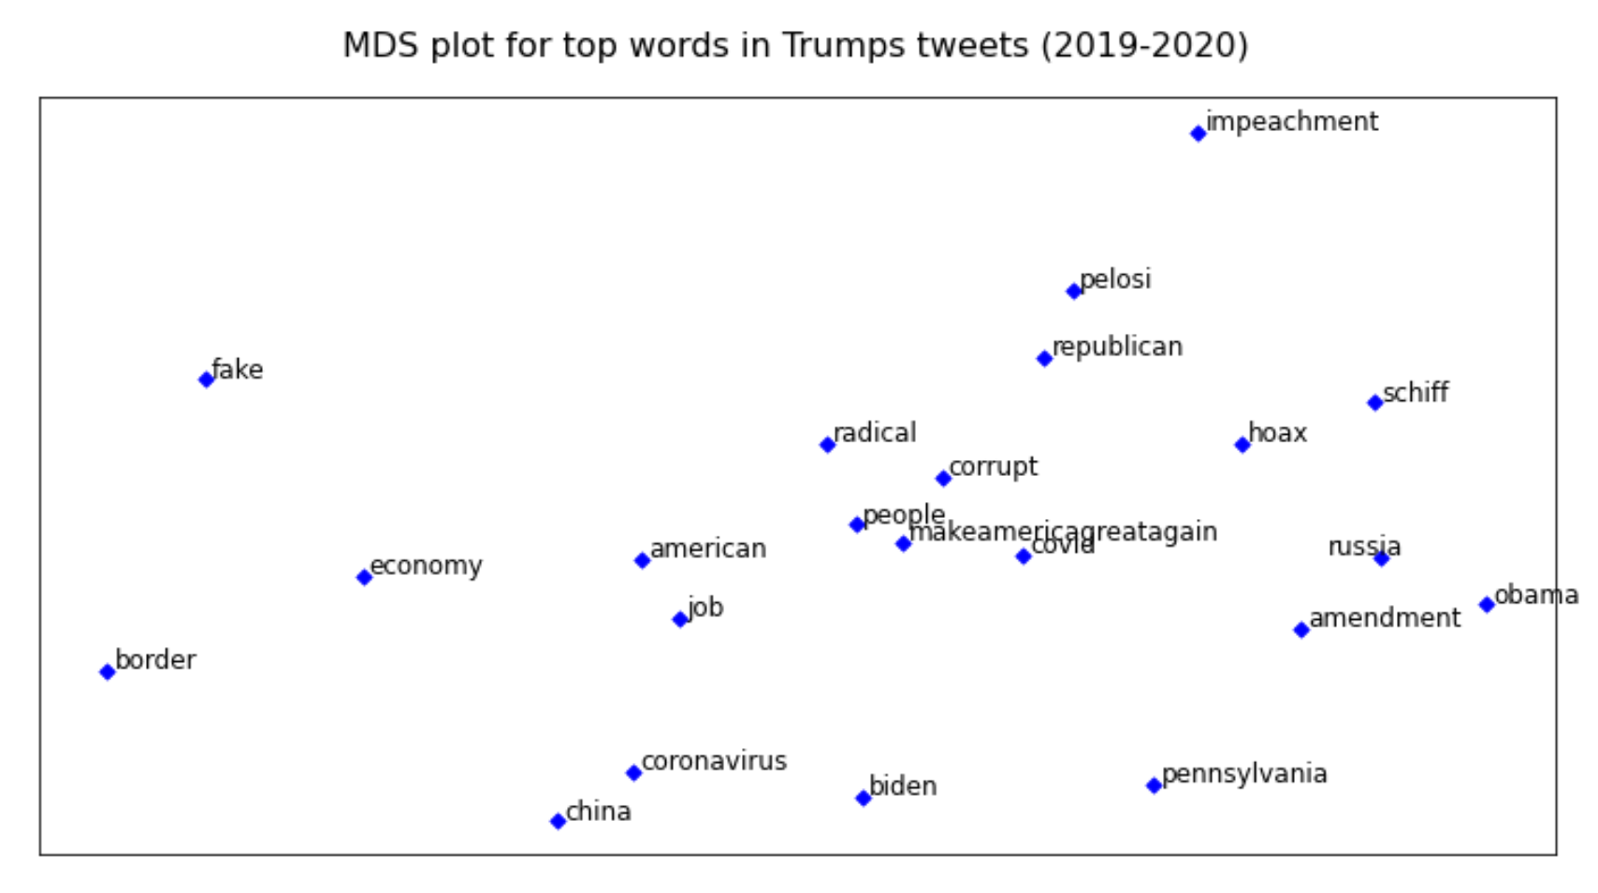

Slide 9
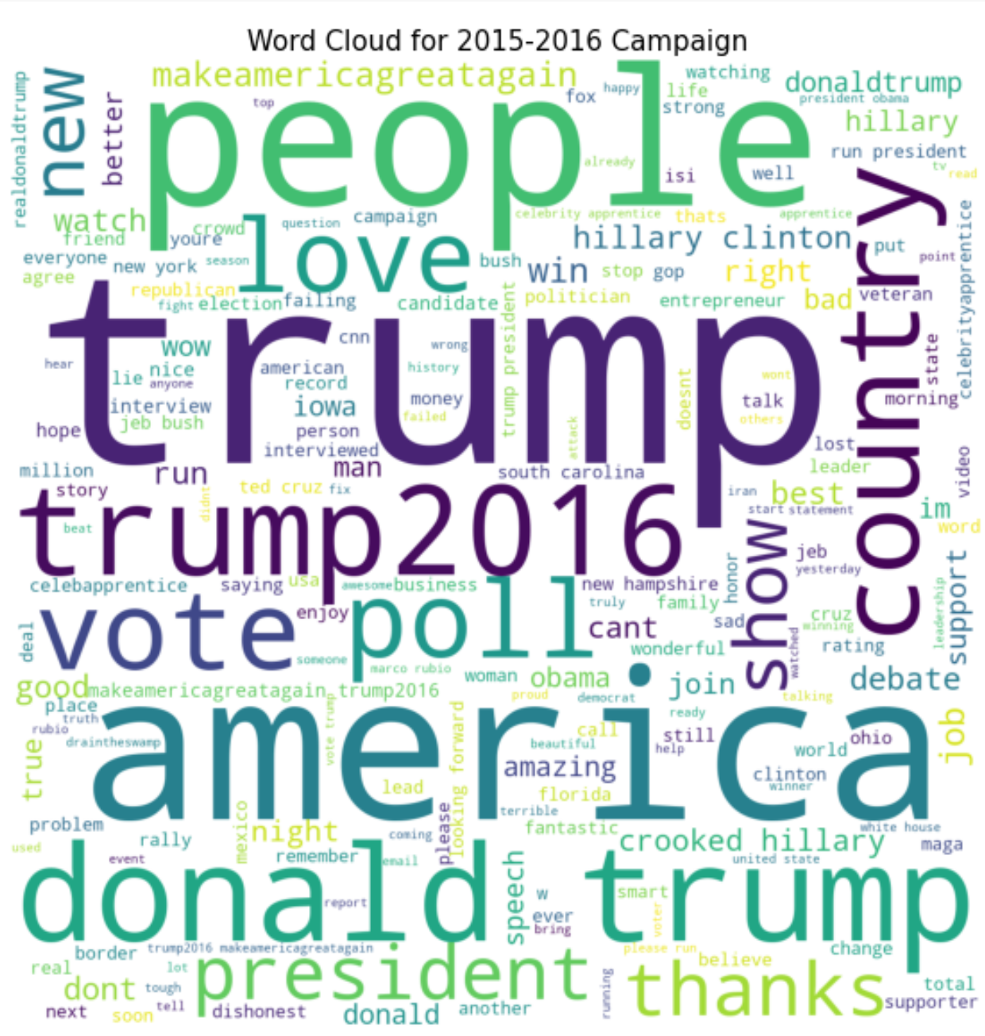
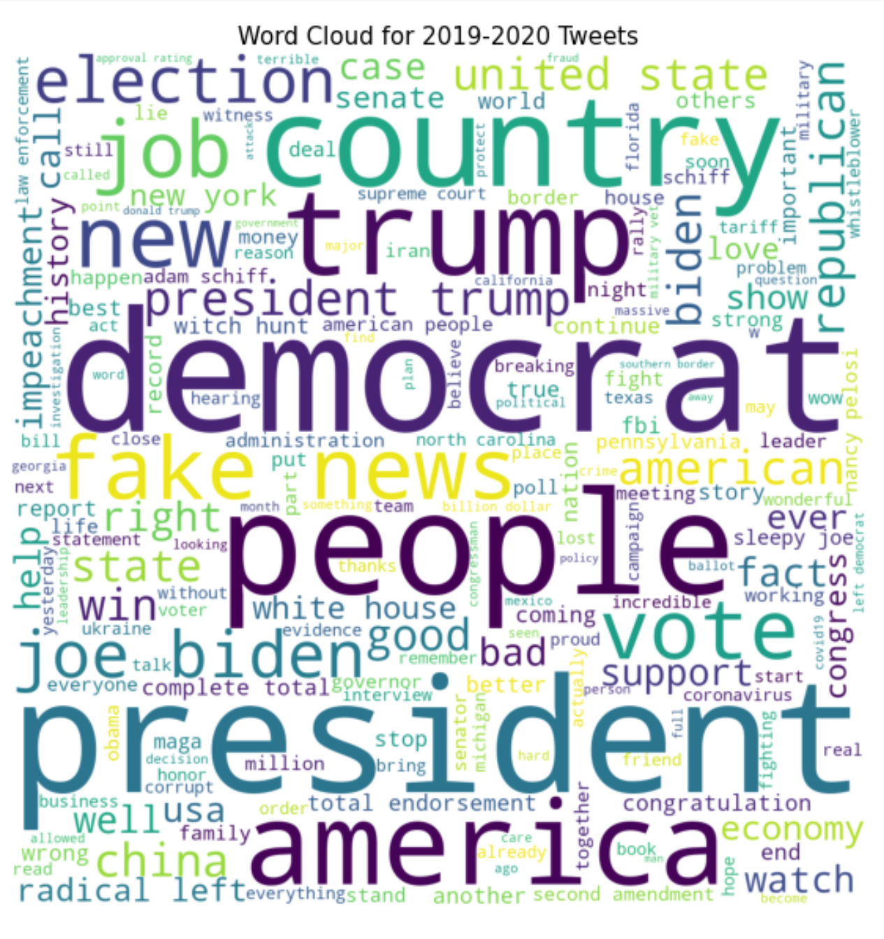

Slide 10
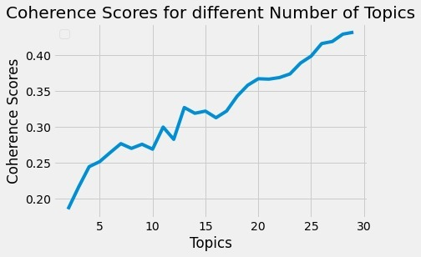
Topic Modeling
Topic 0 words | Topic 0 weights | Topic 1 words | Topic 1 weights | Topic 2 words | Topic 2 weights | Topic 3 words | Topic 3 weights | Topic 4 words | Topic 4 weights | Topic 5 words | Topic 5 weights | Topic 6 words | Topic 6 weights | Topic 7 words | Topic 7 weights | Topic 8 words | Topic 8 weights | Topic 9 words | Topic 9 weights | Topic 10 words | Topic 10 weights | Topic 11 words | Topic 11 weights | Topic 12 words | Topic 12 weights
news | 187.9 | maga | 95.0 | job | 119.2 | house | 97.1 | book | 87.7 | court | 91.9 | pelosi | 90.5 | thank | 458.9 | america | 141.0 | china | 126.7 | deal | 76.9 | win | 80.4 | impeachment | 195.6
fake | 172.3 | florida | 60.3 | president | 112.5 | white | 82.2 | love | 68.1 | law | 88.5 | border | 88.9 | TRUE | 109.6 | national | 104.8 | coronavirus | 89.1 | enjoy | 62.4 | year | 65.7 | schiff | 126.0
election | 151.5 | iran | 52.8 | congratulation | 80.9 | republican | 74.6 | agree | 54.7 | president | 84.9 | nancy | 79.6 | pennsylvania | 43.7 | state | 99.4 | country | 71.5 | billion | 57.2 | carolina | 65.1 | fbi | 89.2
biden | 140.6 | rally | 52.8 | trump | 71.1 | wall | 72.9 | good | 52.5 | conference | 67.7 | total | 77.7 | god | 39.0 | united | 84.7 | drug | 60.9 | fox | 49.5 | north | 60.8 | democrat | 82.8
joe | 133.5 | attack | 43.4 | economy | 69.9 | party | 70.4 | washington | 47.4 | trump | 61.2 | complete | 76.8 | lawyer | 38.0 | president | 66.9 | crazy | 59.6 | interviewed | 45.4 | kag | 59.6 | russia | 82.3
medium | 120.3 | city | 43.3 | honor | 63.8 | approval | 61.1 | new | 40.3 | woman | 60.0 | strong | 76.8 | obstruction | 34.5 | act | 66.8 | biden | 57.4 | historic | 39.7 | office | 54.3 | mueller | 78.6
democrat | 107.6 | kill | 41.0 | american | 53.4 | rating | 59.0 | th | 40.2 | order | 58.6 | endorsement | 72.4 | nice | 32.0 | security | 62.1 | world | 57.3 | israel | 35.7 | market | 52.5 | hunt | 78.1
vote | 105.8 | mayor | 39.1 | morning | 50.9 | leave | 43.9 | people | 37.3 | justice | 55.5 | second | 68.0 | system | 31.9 | democrat | 61.4 | covid | 57.1 | black | 35.2 | amaze | 50.7 | witch | 77.4

Slide 11
Results
2015 - Positive
2019 -
2022 - Higher negativity
We can see that as time went by, Trump’s tweets started to get deleted more. These tweets were seen to have more negative sentiments.
From a word cloud, frequent words from Trump’s tweets included Witch Hunt, Fake, China, Russia, and Impeachment

Slide 12
Insights
Since we can see how Trump’s tweets on controversial topics such as International affairs and false information lead to negative reactions and later deletions, it would make sense to advise Trump to post about different topics. Trump should primarily talk about these controversial topics in speeches and in-person rather than through twitter, which can be seen more as a recreational use.

Slide 13
Recommendations
We would advise Trump to primarily tweet about election reminders, such as when he will be speaking and hosting debates, or current news that would not incur a negative reaction from either parties.
When tweeting, we would recommend that Trump use neutral words that would not lead to negative sentiments.

